Slide 1
CS-Studio: Alarms

Slide 2
BEAST

Slide 3
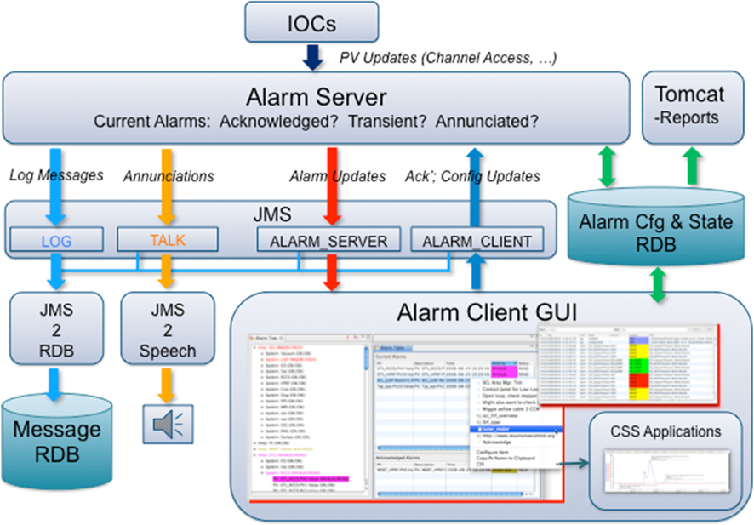
BEAST architecture
Alarm Server
Handles Alarm logic
Stores alarm configuration
Alarm Clients
GUI’s display alarms
GUI’s provide tools to handle alarms (enable, acknowledge, open related display, show guidance)
Annunciator
Alarm message loggers

Slide 4
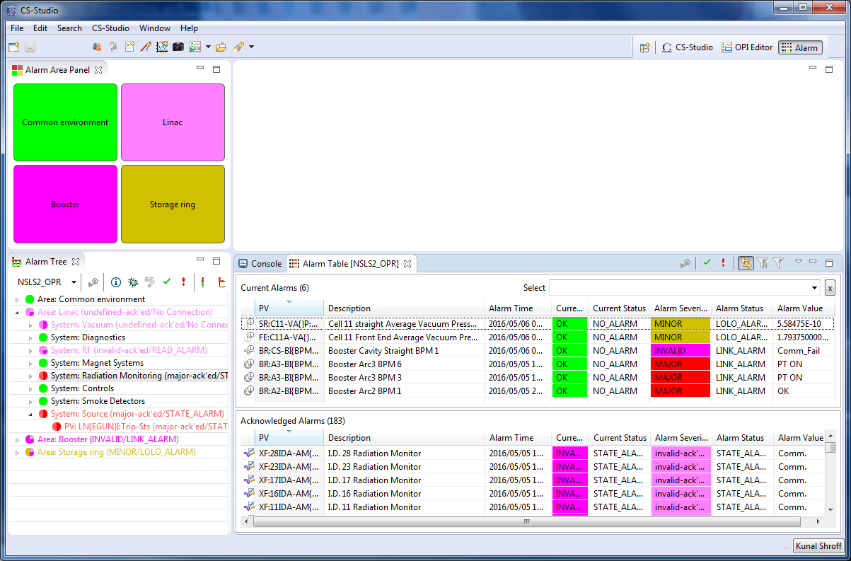
Alarm Perspective

Slide 5
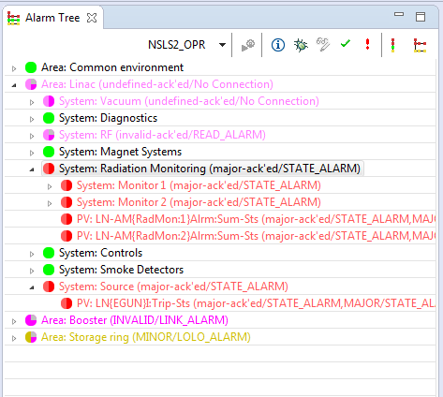
Alarm Tree
Hierarchical view of alarms
Organizes alarms by Area, System, (sub system), PV
Organizes guidance and actions
Alarm handling tools
Acknowledge/Un-acknowledge
Enable/Disable
Guidance, Instructions, and
Alarm configuration actions

Slide 6
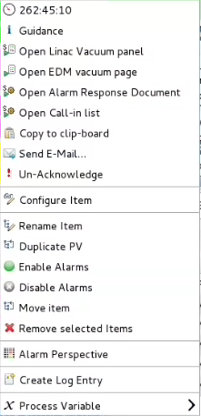
Alarm Context Menu
Alarm information
Alarm handling instructions and actions
Alarm configuration tools
Notes:
The common context menu options for all types of component in the tree are:
Time since event: The elapsed time since the alarm happened.
Guidance messages: If there are guidance messages configured for the item, it will be displayed here one by one.
Related displays: If there are related displays configured for the item, it will be displayed here one by one. When you click one of them, the related display will be launched.
Commands: If there are related commands configured for the item, it will be displayed here one by one. When you click one of them, the related command will be executed.
/ Acknowledge/Un-Acknowledge:The common context menu options for all types of component in the tree are:
Time since event: The elapsed time since the alarm happened.
Guidance messages: If there are guidance messages configured for the item, it will be displayed here one by one.
Related displays: If there are related displays configured for the item, it will be displayed here one by one. When you click one of them, the related display will be launched.
Commands: If there are related commands configured for the item, it will be displayed here one by one. When you click one of them, the related command will be executed.
/ Acknowledge/Un-Acknowledge: This option will be displayed only when the item is not in an "OK/OK/OK" state. If this is an un-acknowledged item, the option would be "Acknowledge" so that you can acknowledge it, and vice versa.
Configure Item: For a PV item, you have several properties to configure: Alarm PV Configuration. For the non-PV component, you can configure its guidance, displays and commands. Tree elements also "inherits" guidance, display and commands from its parent entries.
Rename Item: Rename the selected item.
Duplicate PV: Create a new PV which has the same settings as the selected PV. This is a convenient way to create similar alarm PVs by configuring the first PV, then duplicating it. You can of course later configure the newly created duplicate.
Move Item: Move the selected items to another path in the tree.
Remove Selected Items: Delete the selected items from the tree and hence from the configuration.
This option will be displayed only when the item is not in an "OK/OK/OK" state. If this is an un-acknowledged item, the option would be "Acknowledge" so that you can acknowledge it, and vice versa.
Configure Item: For a PV item, you have several properties to configure: Alarm PV Configuration. For the non-PV component, you can configure its guidance, displays and commands. Tree elements also "inherits" guidance, display and commands from its parent entries.
Rename Item: Rename the selected item.
Duplicate PV: Create a new PV which has the same settings as the selected PV. This is a convenient way to create similar alarm PVs by configuring the first PV, then duplicating it. You can of course later configure the newly created duplicate.
Move Item: Move the selected items to another path in the tree.
Remove Selected Items: Delete the selected items from the tree and hence from the configuration.

Slide 7
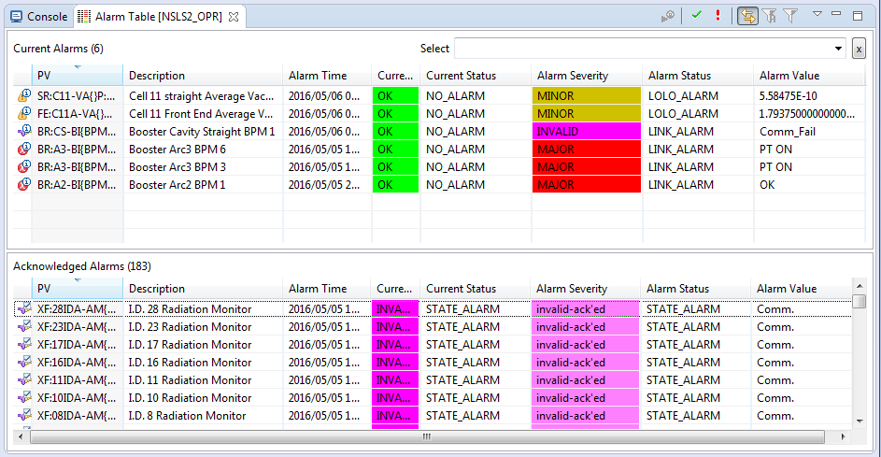
Alarm Table

Slide 8
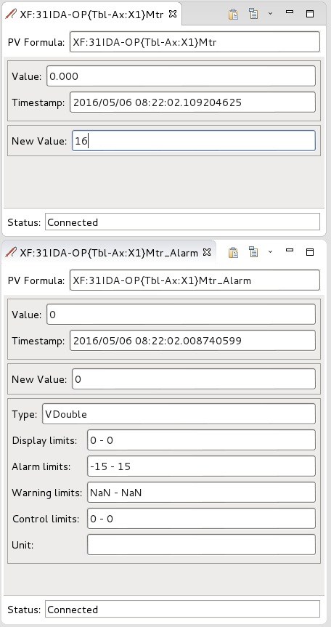
Exercise: Handling Alarms
We shall create an alarm by moving a motor beyond the safe range or +/- 15
Motor setpoint pv
XF:31IDA-OP{Tbl-Ax:X1}Mtr
Alarm PV
XF:31IDA-OP{Tbl-Ax:X1}Mtr_Alarm

Slide 9
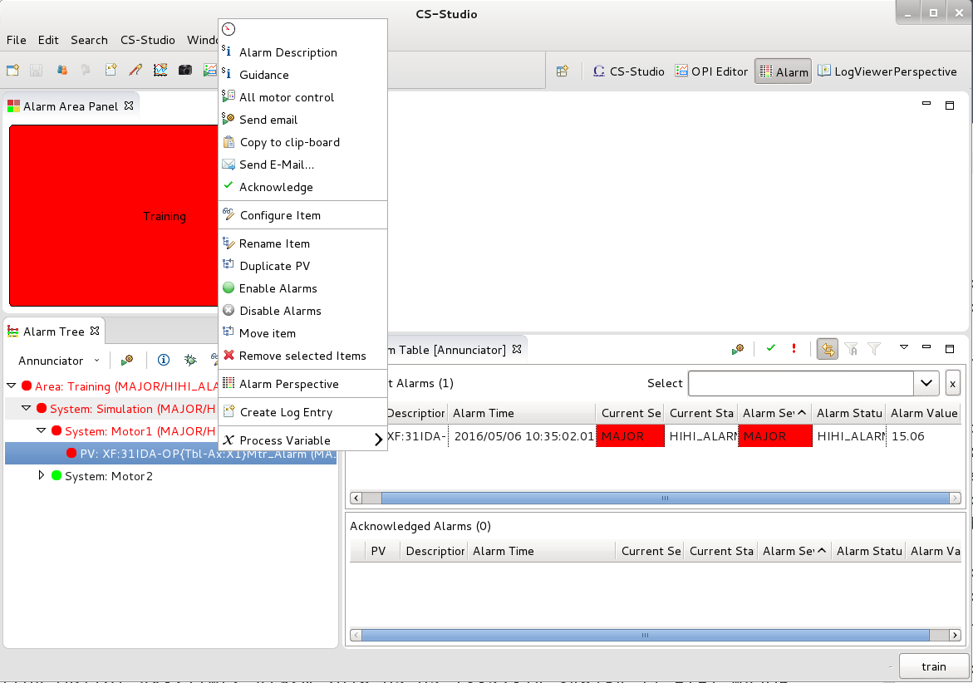
Exercise: Handling Alarms
Open the context menu which contains
Alarm Description
Guidance (how the alarm should be handled)
Actions to open related opi screens and/or commands

Slide 10
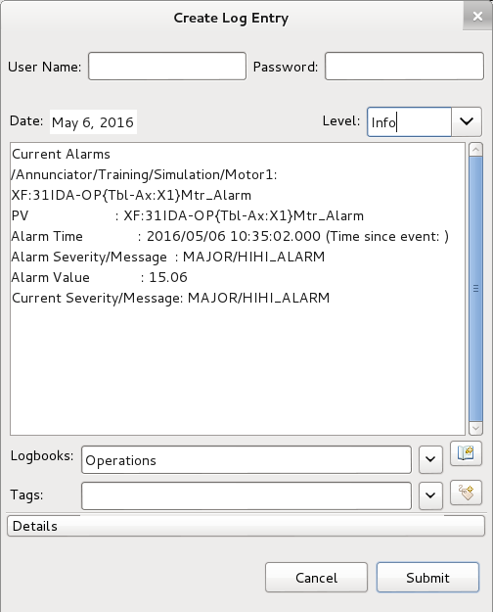
Exercise: Handling Alarms
Acknowledge alarm
Create a log entry for the alarm
Open related motor control opi and set the motor position set point with in the appropriate range

Slide 11
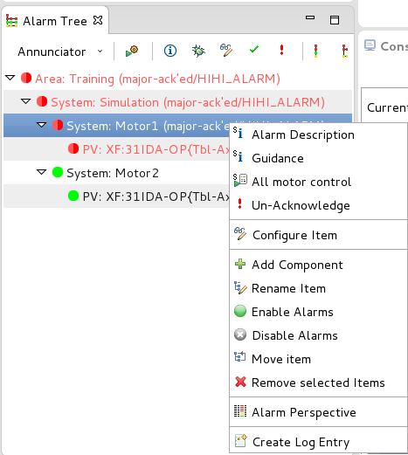
Configuring BEAST
The context menu of the alarm tree provides commands to
Add/Remove new alarm components
Reorganize existing components in the alarm hierarchy
Configure the information and actions associated with alarms

Slide 12
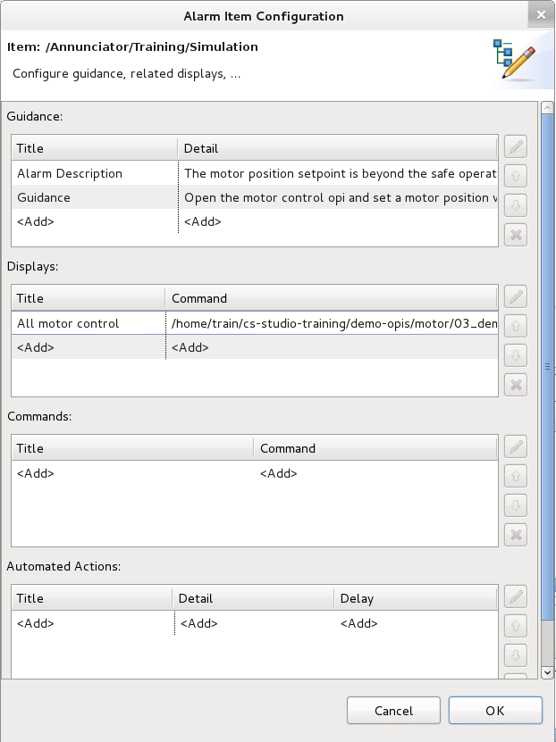
BEAST configuration dialog
Guidance: These are simple text messages which can be used to
Describe the alarm condition, including possible causes
Provide information/instructions on how this alarm should be handled

Slide 13
BEAST configuration dialog
Links alarms with the related opi screens
Allow users to directly open BOY/databrowsers files without navigation
Link to .opi, .plt,

Slide 14
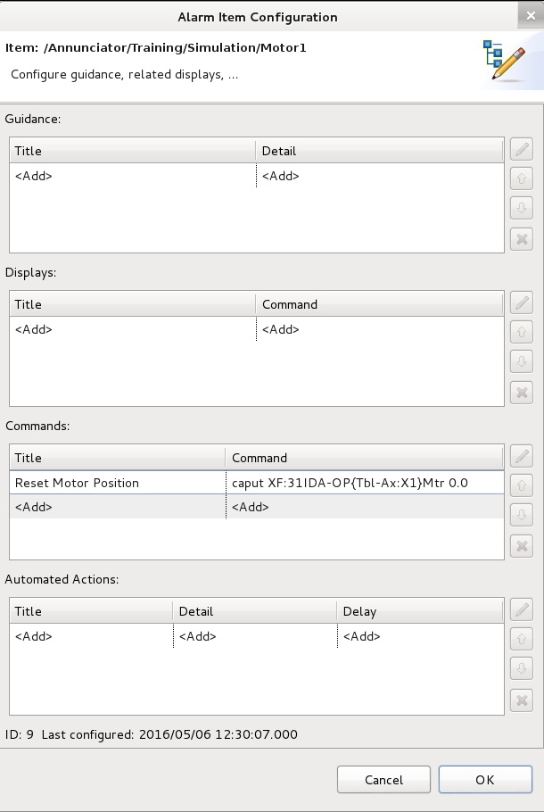
BEAST configuration dialog
Commands:
Allows defining actions which invoke external commands
Automated Actions:
If alarms persist for a certain time without being acknowledged or cleared, and automated notification can be generated.

Slide 15
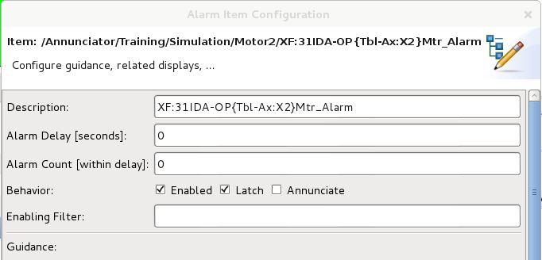
BEAST configuration dialog
Alarm Trigger PV Configuration
Alarm Delay and Alarm Count
Wait for alarms that are active for at least the specified delay or occur more than the specified count
Latch
The highest alarm states are remembered until acknowledged
Enable (discouraged)
Filter (discouraged)

Slide 16
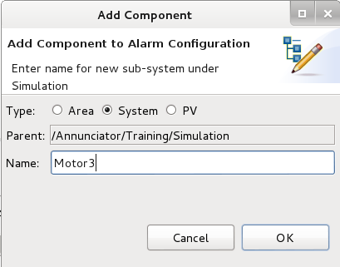
Exercise: Configuring Alarms
Goal: To create a new set of alarms for Simulated Motor 3
Under System: Simulation add a new component
Type: System
Name: Motor3

Slide 17
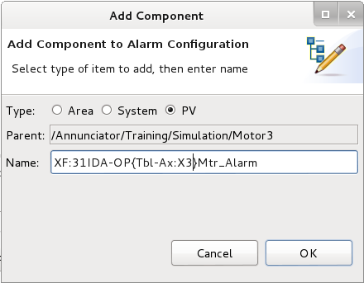
Exercise: Configuring Alarms
Goal: To create a new set of alarms for Simulated Motor 3
Under System: Motor3 add a new component
Type: PV
Name: XF:31IDA-OP{Tbl-Ax:X3}Mtr_Alarm

Slide 18
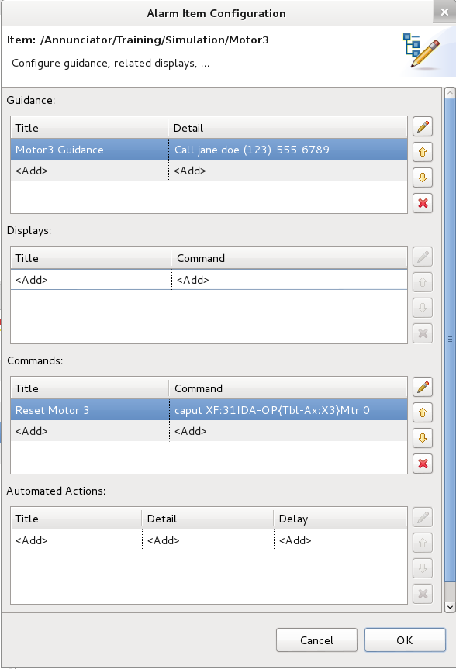
Exercise: Configuring Alarms
Add Guidance/Instructions on how this alarm should be handled
Add a command that will reset the motor set point
Title: Reset Motor 3
Command: caput caput XF:31IDA-OP{Tbl-Ax:X3}Mtr 0.0

Slide 19
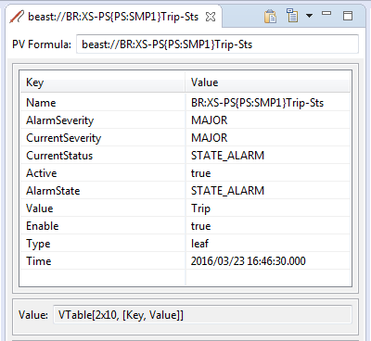
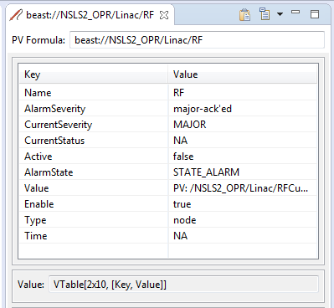
Alarm Datasource
'beast' pvs can be used to connect to any node or leaf from the alarm tree.
beast://alarm_trigger_pvName beast://complete_path_to_area beast://complete_path_to_system

Slide 20
Alarm Datasource
In addition of the table it is also possible to create a channel directly to some of the fields of the table
beast://complete_path_to_system.AlarmSeverity
The severity of the PV remembered by alarm server. When the PV is configured to "latch", the alarm server remembers the highest alarm severity of the PV until it is manually acknowledged.
beast://complete_path_to_area.Acknowledge
Returns a boolean value representing is the Alarm has been acknowledged. true if severity indicates an acknowledged alarm (AlarmSeverity is *-ack'ed). false for unacknowledged or OK state.
beast://complete_path_to_system.Active
Creates a Channel which represents if the alarm is active.

